Slide 1
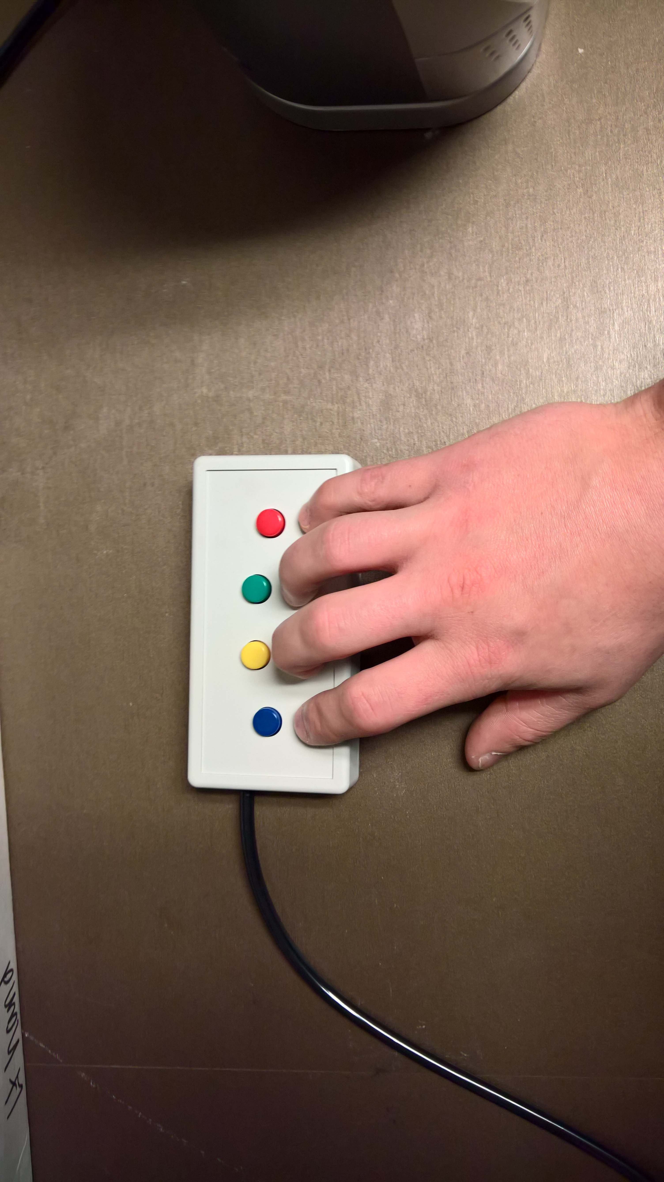
Position your hands so that your
index finger corresponds to the LEFT Button
and your
middle finger corresponds to the RIGHT Button
LEFT
RIGHT
RIGHT
PRESS THE RIGHT BUTTON TO CONTINUE

Slide 2

Attentional Control Task
Practice:
RIGHT HAND
RIGHT
PRESS THE RIGHT BUTTON TO CONTINUE
Notes:
Outside the scanner

Slide 3
Attentional Control Task
Practice:
LEFT HAND
RIGHT
PRESS THE RIGHT BUTTON TO CONTINUE
Notes:
Outside the scanner

Slide 4
Attentional Control Task
Scan: Run 1
RIGHT HAND
RIGHT
PRESS THE RIGHT BUTTON TO CONTINUE
Notes:
Outside the scanner

Slide 5
Attentional Control Task
Scan: Run 1
LEFT HAND
RIGHT
PRESS THE RIGHT BUTTON TO CONTINUE
Notes:
Outside the scanner

Slide 6
Attentional Control Task
Scan: Run 2
RIGHT HAND
RIGHT
PRESS THE RIGHT BUTTON TO CONTINUE
Notes:
Outside the scanner

Slide 7
Attentional Control Task
Scan: Run 2
LEFT HAND
RIGHT
PRESS THE RIGHT BUTTON TO CONTINUE
Notes:
Outside the scanner

Slide 8
Attentional Control Task
Scan: Run 3
RIGHT HAND
RIGHT
PRESS THE RIGHT BUTTON TO CONTINUE
Notes:
Outside the scanner

Slide 9
Attentional Control Task
Scan: Run 3
LEFT HAND
RIGHT
PRESS THE RIGHT BUTTON TO CONTINUE
Notes:
Outside the scanner

Slide 10
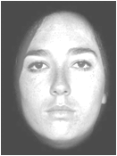
In this task, you will see a series of images of faces and rows of letters in the center of the screen.
HKNMWZ
RIGHT
PRESS THE RIGHT BUTTON TO CONTINUE
Notes:
Add screenshots of an X and an O screen – like a timeline of screenshots.

Slide 11
Each row can be either:
All Ns,
All Xs,
A string containing one N and other letters
Or a string containing one X and other letters.
RIGHT
PRESS THE RIGHT BUTTON TO CONTINUE
Notes:
Add screenshots of an X and an O screen – like a timeline of screenshots.

Slide 12
Your task:
Press the left button (index finger)
when there is an N,
and
Press the right button (middle finger)
when there is an X.
RIGHT
PRESS THE RIGHT BUTTON TO CONTINUE
Notes:
Add screenshots of an X and an O screen – like a timeline of screenshots.

Slide 13
Your task:
Press the left button (middle finger)
when there is an N,
and
Press the right button (index finger)
when there is an X.
RIGHT
PRESS THE RIGHT BUTTON TO CONTINUE
Notes:
Version for LEFT hand

Slide 14
You will see groups of same letter trials OR mixed letter trials.
Please respond as FAST and ACCURATELY as possible.
The stimuli will be very brief so it is important that you maintain your focus
throughout the whole experiment.
RIGHT
PRESS THE RIGHT BUTTON TO CONTINUE
Notes:
Add screenshots of an X and an O screen – like a timeline of screenshots.

Slide 15
Here are some examples of same letter trials.
Same letter trials
NNNNNN
XXXXXX
PRESS LEFT
PRESS RIGHT
RIGHT
PRESS THE RIGHT BUTTON TO CONTINUE
Notes:
Add screenshots of an X and an O screen – like a timeline of screenshots.

Slide 16
Here are some examples of mixed letter trials
mixed letter trials
HKNMWZ
HKXMWZ
PRESS LEFT
PRESS RIGHT
RIGHT
PRESS THE RIGHT BUTTON TO CONTINUE
Notes:
Add screenshots of an X and an O screen – like a timeline of screenshots.

Slide 17
This is the same task as the one you just completed
RIGHT
PRESS THE RIGHT BUTTON TO CONTINUE
Notes:
Add screenshots of an X and an O screen – like a timeline of screenshots.

Slide 18
When you are ready,
Press the RIGHT Button to continue
Notes:
Add screenshots of an X and an O screen – like a timeline of screenshots.

Slide 19
We will now swap the button box for the joystick to be used for the next tasks.
Notes:
Add screenshots of an X and an O screen – like a timeline of screenshots.

Slide 20

Position your hands so that your
middle finger corresponds to the LEFT Button
and your
index finger corresponds to the RIGHT Button
LEFT
RIGHT
RIGHT
PRESS THE RIGHT BUTTON TO CONTINUE

